Slide 1














Web Scraping for Data Collection and Analysis
Case Study: Scraping Data from TutorialsFreak

Slide 2

Introduction
Objective:
To scrape data from a website, save it in a CSV, and visualize the results.
Website Chosen:
TutorialsFreak (https://www.tutorialsfreak.com/)
Data Extracted:
Titles, URLs, Dates, Categories of Tutorials

Slide 3
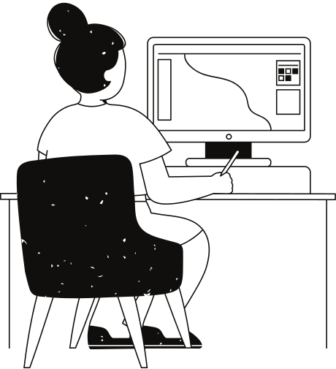
Tools and Libraries Used
Python:
Programming language for the project.
Libraries:
Requests: For fetching web page content.
BeautifulSoup: For parsing and extracting HTML data.
CSV: For saving extracted data into a CSV file.
Pandas & Matplotlib: For data analysis and visualization.

Slide 4

Data Points and Structure
Data Points Extracted:
Title: Tutorial title
URL: Direct link to the tutorial
Date: Published date
Category: Topic category (e.g., Python, JavaScript)
Website Structure:
HTML tags identified using developer tools:
Titles: <h2>
URLs: <a>
Dates: <time>
Categories: <span>

Slide 5
Code Implementations
01
02
03
04
Parse HTML:
With BeautifulSoup
Extract Data:
Identify tags and extract
the needed information
Save Data:
Write the data into a CSV file
using the csv.writer function
Fetch HTML:
Using requests.get()

Slide 6
CSV Data Output
CSV File Content:
Sample data:
Title: Learn Python Basics
URL: https://www.tutorialsfreak.com/python-basics
Date: 2024-11-06
Category: Python
Data Structure:
12 rows, 4 columns (Title, URL, Date, Category)

Slide 7
Visualization
Objective: To visualize the distribution of tutorials by category.
Visualization Tool: Matplotlib
Type of Visualization:
Bar Chart: Shows the number of tutorials in each category.
Insights:
Python tutorials are most frequent.
JavaScript also has a significant number.

Slide 8

Challenges and Solutions
Challenges:
Website structure understanding: Identifying correct tags.
Handling missing data: Some tutorials had missing categories or dates.
Performance: Limiting the number of scraped items to avoid overload.
Visualization with small data: Insights were limited due to dataset size.
Solutions:
Used placeholders for missing data.
Limited scraping to a few tutorials for demonstration.

Slide 9
Thank you very much!
Presented by Nishtha Yadav

